Slide 1

Society Culture Conformity Deviance

Slide 2
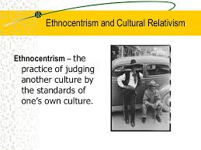
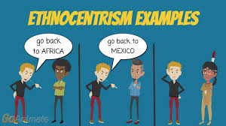
A Fish in the ocean…. ethnocentrism
A way of Being – Peopleness
Structures that make us different
Narrow orientation to the world
Seeing outside the boundaries of our life
Notes:
Other vantage point than our own- the sociological imagination
See beyond your boundaries
Other ways of being outside of the water – even an amphibian

Slide 3
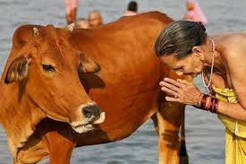
The Cow in India… a refrigerator …
Notes:
India-Roaming cow is a refrigerator- respecting the cow is respecting the society and integrating into the social; useful for many other purposes; source of fuel and protein

Slide 4
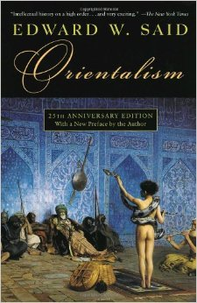
Orientalism Exoticing the east
Notes:
Orientalism is a prism to view the eastern world- a exotic; illiterate; unworthy of governing themselves

Slide 5
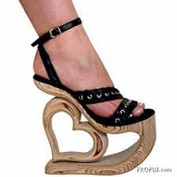
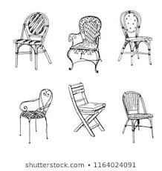
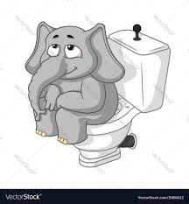
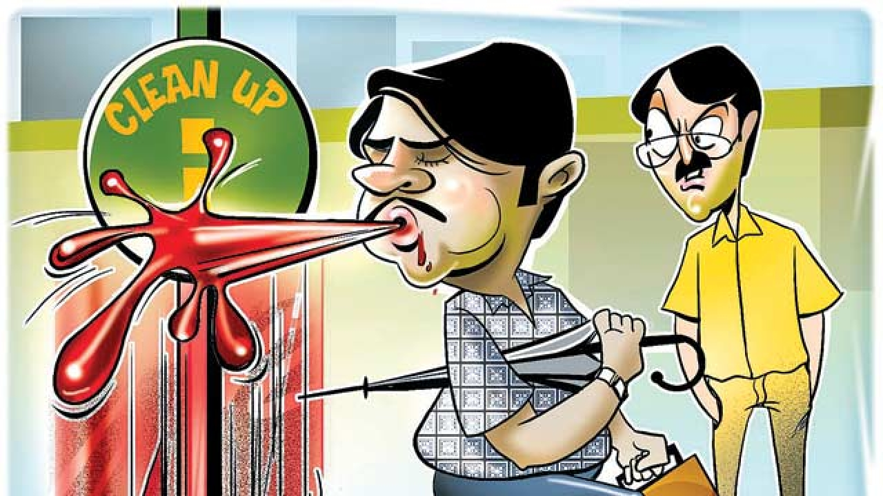
The Coming of the Chair…
The Western Toilet
High heeled shoes
Spitting in Public
Driving on the Left
Notes:
– the coming of the chair – very few sat in one through history- for us its natural – the hardware to support our state - we take it to be naturel
chair or not a chair is done by social agreement – conformity!
Chair as tool has affected the body! Parts of a cultural body – respect/power…
Sleeping practices! Siesta! Industry work- no provision for siesta!
Spitting in public! Is cultural tolerance

Slide 6
How other people live! Malinowski – 1884-1942
Placing the strange in context
Understanding Culture Non - Judgmentally
The Prism of Western Civilization
Seeing the world without Bias!
Notes:
Malinowski – 1884-1942- LSE – Anthropology and Imperialism- role of the anthropologist- How other people live!
Anthropologists were Knowledge producers for the colony
– with Empathy and being Non Judgmental ; to learn – not through the prism of western civilization
See the world stripped of your own biases- preach respect about differences

Slide 7
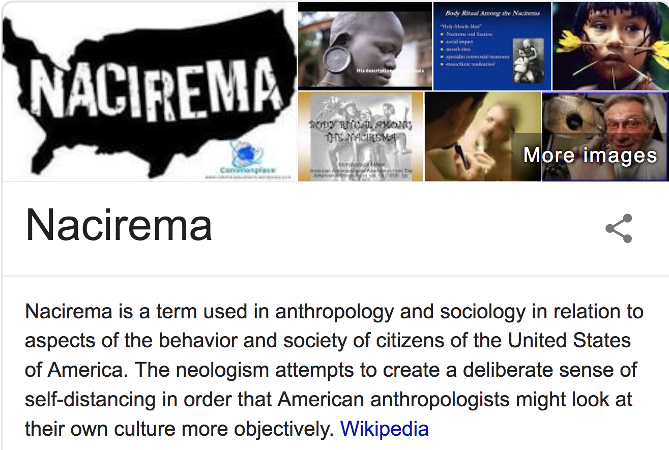

Slide 8
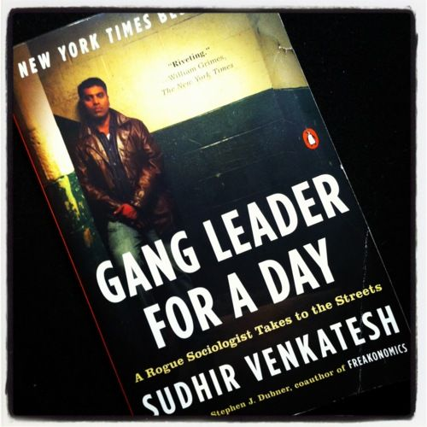
Gang leader for a day!

Slide 9
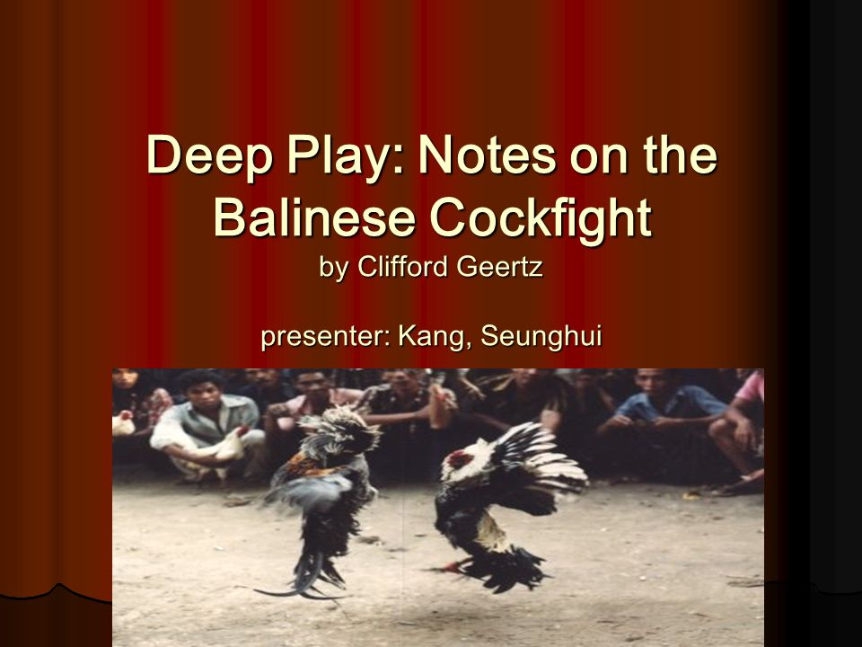
Rituals … what purpose they have…
Notes:
Culture is essentially making meaning – telling stories about ourselves- interpreting the world for ourselves
Elaborate rituals d exactly that – by ritual also functions to seal the membership of those who participate in it into the society

Slide 10
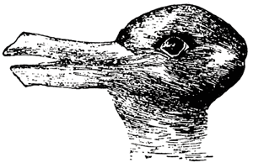
Notes:
Duck and the Bunny
Duck seeing –cues indicators- human evolve socially- needs that external input

Slide 11
Ways of Seeing … the World around you

Slide 12
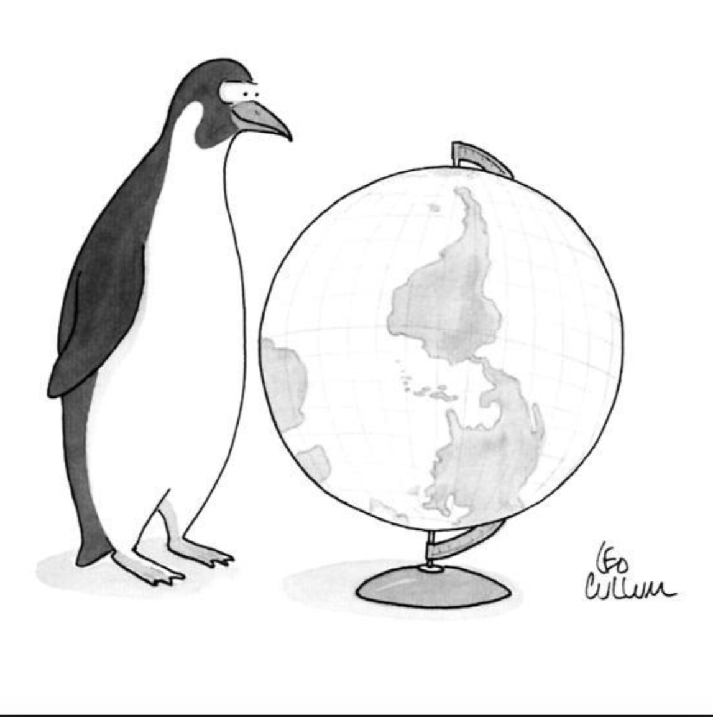
New Yorker April 20th, 1992 by Leo Cullum
Notes:
What's east and west
How different is different
How much should someone be different before we think they are different from us….
Essentially different – essentialism in understanding difference
Do different cultures live in different modes of consciousness – what is the source for arriving at this conclusion..

Slide 13
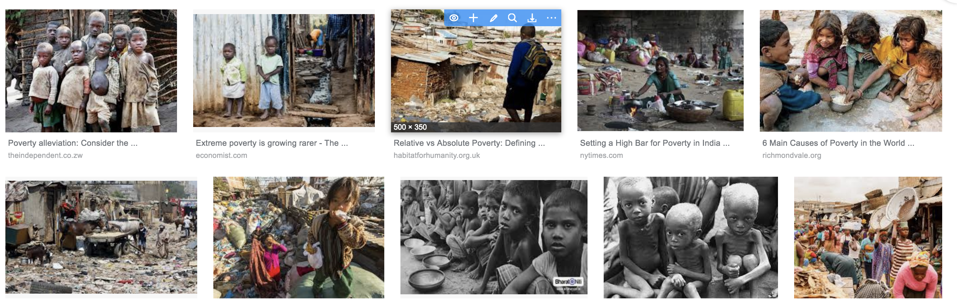
What and How is Poverty??
Notes:
What Causes Poverty-why specific parts of the world- racial association with poverty- something about the poor?
A culture of poverty – bio different?? Don’t think about tomorrow- don’t save- effort to improve…
Blaming the victim- savages of Africa- did not have souls!
Negative essentialisms!
Your perspective Your Location – Duck ways Bunny Ways – through socialization process – what you learn is what your are in that worlds- where are you coming form

Slide 14
Look… what do you do with cultural differences….
Notes:
We do see people differently . We do classify people or cultures
Organized differences that have consequences- the sociological imagination helps notice how this process works…
We can do good and we can do bad with these differences…

Slide 15
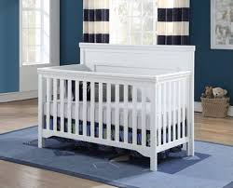
Culture … The social condition?
Notes:
Social condition is the only condition- white children died in orphanages- healthy bodies as physical not social- physiological survival is in social interaction – touch feel stimulation
World as ambiguous
outside factor helps to see – more ambiguous the stimulus - the more social inputs needed –

Slide 16
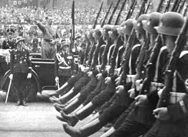
Beethoven and genocide
Notes:
WW2- Nazi prevailing- Beethoven and Genocide- Being German causes people to see the world in particular ways-

Slide 17

The banality of evil…
Notes:
Hannah Arendt – Eichmann – logistic bureaucratic to kill millions – a job – Banality of evil- an ordinary guy! Not specific to Germany at all!

Slide 18

The Milgram experiment
Notes:
Milgram – Shock Delivery – pressure to confirm from authority not group pressure –
The Milgram experiment
Poster boy of human centered research - Milgram cannot happen any more due to concerns of safety security and privacy of humans as research subjects

Slide 19
The white coat…
The Authoritarian personality
The Zeal to obey order
Enough social conformity for Anti-Semitism
Notes:
White coated authority in human interactions – with vast consequences
Authoritarian personality
Zeal for order – Authoritarian personality – not Bio but cultural
Enough conformity to launch the Nazis

Slide 20
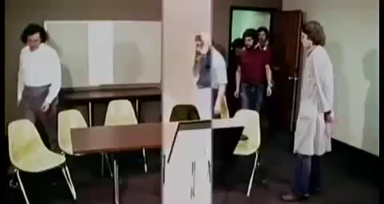
The Asch Conformity experiment
Notes:
ASCH experiment – massive rates of conformity- cross pressures – group pressure for conformity

Slide 21
Who are the exceptions

Slide 22
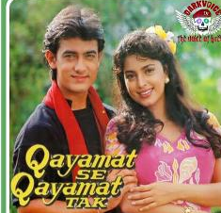
The ally in Non-conformity … two to tango

Slide 23
Labelling … society culture individual
Notes:
Chambliss – Labelling process – what is transgressing!
Study in social class – doing things that conforms to an in-group - who are you conforming to – sub-cultures- consequences for sticking to a group
Finding people you make solidarity with - conditions of life Social Class- nudges to being one way!
Conformity as inevitable across settings
Root to dignity is displaying allegiance/lining up with people like you
To differentiate and then label…

Slide 24
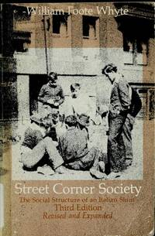
The street corner society

Slide 25
Non-conformity- again… it takes two to tango…
Notes:
Patterns in interruptions in integrative mechanisms – just like the smooth ones
Some types and groups seem to break with the pattern – Deviance
Deviance takes two to tango – someone who does and someone who identifies it as deviant/off course in a negative way l- labels have consequences

Slide 26
What in the devil got into you… understanding “deviance’
Notes:
How do you identify something as wrong? Non-sociological orientations…
Interpretations- soul/devil/bio pheno to explain these deviant outcomes
The Psys say not always bio – Personality during infancy etc…early experiences in life – this is socio not Bio or Psych- not the best way to get explanations
Situation that call forth this behavior – you are in a situation not evil/odd/derailed
If its Bio how could rates of suicide matches countries and groups and historical time
Heights of deviance is situational – why are divorce rates more Urban?

Slide 27
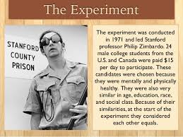
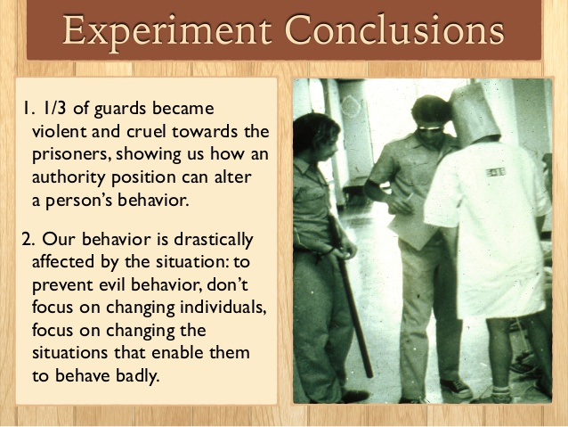
The Zimbardo experiment… Stanford 1971
Notes:
Prison in Stanford – Zimbardo – Roles – Costumes- took them on and enacted them- Jailers & Convicts
Close the experiment prematurely…

Slide 28
Deviance Addiction Stigma… ethnocentrism
Notes:
An exploratory framework
Deviance in a prior moment seem foolish – not so easy identification- what is weird then vs what is now… it’s the set up not the essence
Deviances are organized in many ways… coco cola until 1906- wine cocaine sweet syrup- 1914 made drugs illegal – ways of getting stoned- who is using it and what's worrisome…
Addiction – what sorts are abusive and deemed socially
Deviance structures seemingly foolish looked at from a time you are living in
Ethnocentrism- making us see deviance in particular ways – Idea of Stigma – process of labeling negative- marked as one – how to classify – laid on – special schools/therapy-
Howard Becker- Moral entrepreneurs – made their life in morally policing deviance- Informally Gossip
Becoming a Marijuana user- how to get stones- social aspects of the deviant act – doing it with other people in the know- not like eating a doughnut- Giggling becomes applause- Suffuses through – ignorance does not prompt such reactions – social interactions and contexts that surrounds is intrinsic to what it meant to doing something micro cues ti do a collective act just like the applause clap-trap

Slide 29
Deviance as an ensemble and process…
Question- is anything Evil if everything is Relative…
Notes:
Lord Humphries –micro moves through which we understand – gay lives in men’s rooms- learning micro interactional knowledge and skill – Larry Craig-– complicated choreography to learn micro moves and interactional knowledge needed to understand the condition or identity
Gay as a kind of human being- a moment identified as something to worry about- circle drawn and do something – Humphries and a study full of deception
Durkheim on Deviance – mark one another off from other cultures- rules and boundaries- to identify a group or a culture or country – Eating meat of a kind- that’s who we are – relativist orientations- no out group no in group- should and shouldn't- trespasses- mechanisms through which tine society holds together and identifies itself with ‘
Deviance- an ensemble a process not an essence- Dilemma!- is nothing evil! Free will! Situational! If context causes then should everything be forgiven… is anything wrong in themselves or right in themselves
Relativity to the situation- laws of human nature that cannot be crossed no matter the culture

Slide 30
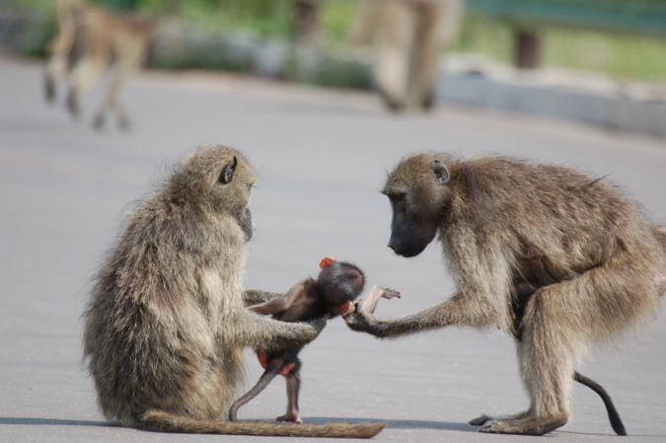
Baboons r us - studying culture
Notes:
Conditions not people – so manipulate the contingencies by which people operate – Baboons something like a human culture – can they be aggressive; feminist; hierarchical; macho – the accident that happened – bad guys died! New bad arose not in the same ways! New recruits are socialized differently- something about a culture that can be more aggressive or less and can perpetuate itself- the way society is organized- countries organized for war! Now Germany does not adopt capital Punishment!

Slide 31
Sorting apparatus is Hierarchical…
Notes:
Way this has been organized – abusive environments- abuse of power institutionalized- the insti set up the sociological explanation- mode of thinking and explaining- Patterns to this deviance – ordinary behavior a floating system of stigma through routine interactions apart from the labelling – Moral DOL pointing out moral failing- someone has sinned and what to do- moral industry- teaches therapists etc.…
Police Courts Labeling as a system and institutionally located- when one sin/problem begins and ends- who gets what punishment- professional and organisation work of enormous scale-
Sorting apparatus – who gets punished and for what- a mechanism for – race class gender – hierarchy of credibility – to call out someone else is deviant – where you are in the institutional set up – capacity to influence who gets identifies as deviant- and also to deviant ‘deviant’ – vast consequences

Slide 32
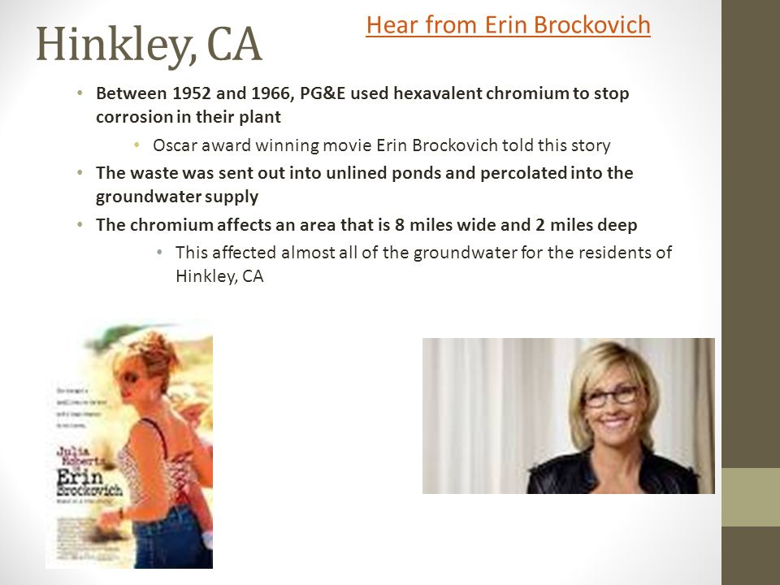
Industry Crimes that have to be proved…

Slide 33
The hierarchy of credibility…
Notes:
Sorting apparatus – where you are in the institutional set up… not just money … in order to decide what is punishable and deviant
Capacity to decriminalize what apparently is criminal
which sort get punished and harshly- crack cocaine Hooch – poor people’s crimes – generates a whole series of phenomena – Policing – prison- biased towards young men – confrontation
Rich people’s crime – industrial pollution – war crimes – war in Iraq – asbestos – one in 5 cancer are job related
Victims and status – degree of punishment Labelling as organized and institutionalized – naturalized
Race as institutionalized – you don’t need to be deliberate or racist
Part of the social machine- naturalized – automatic -
Differential consequences for status etc.… happens in an automatic way
Getting what they deserved – seen as essentially deviant – who goes to prison
Capacity to see people as different and serving of punishment – do we see them as part of organisational and institutional set ups

